Slide 1
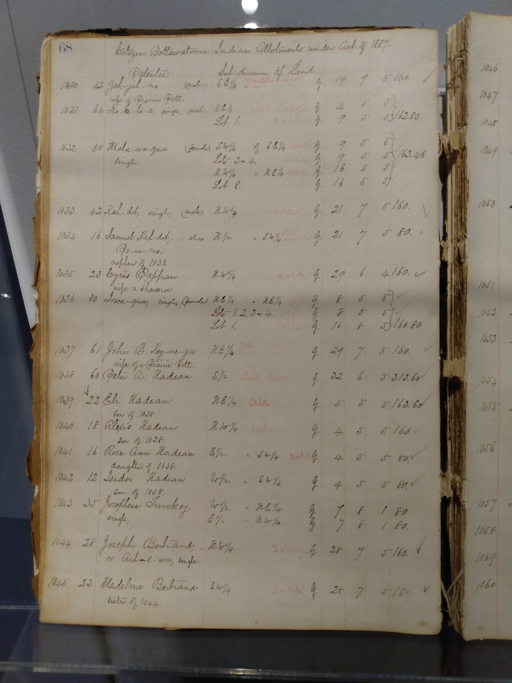
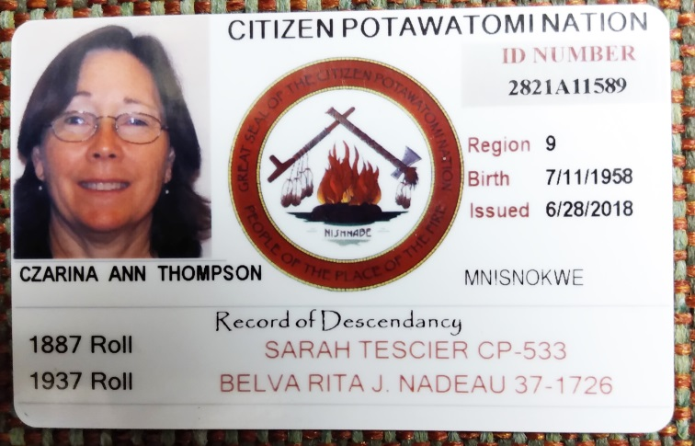
All Citizen Potawatomi Nation Tribal Members
Should have a direct Family Ancestor on the
1887 or 1872 allotment lists.

Slide 2
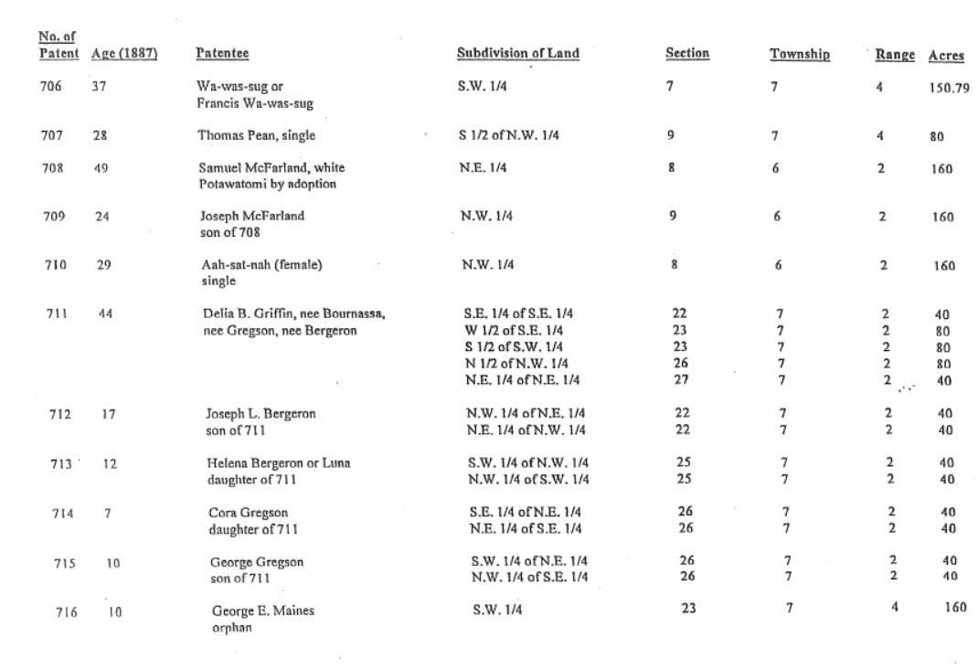
CP in front of a number = to the Act of 1887 Allottee
1362 + Patentees /Allottees on the 1887
“NEE” (NAY)= MAIDEN NAME , BUT NOT ALWAYS

Slide 3
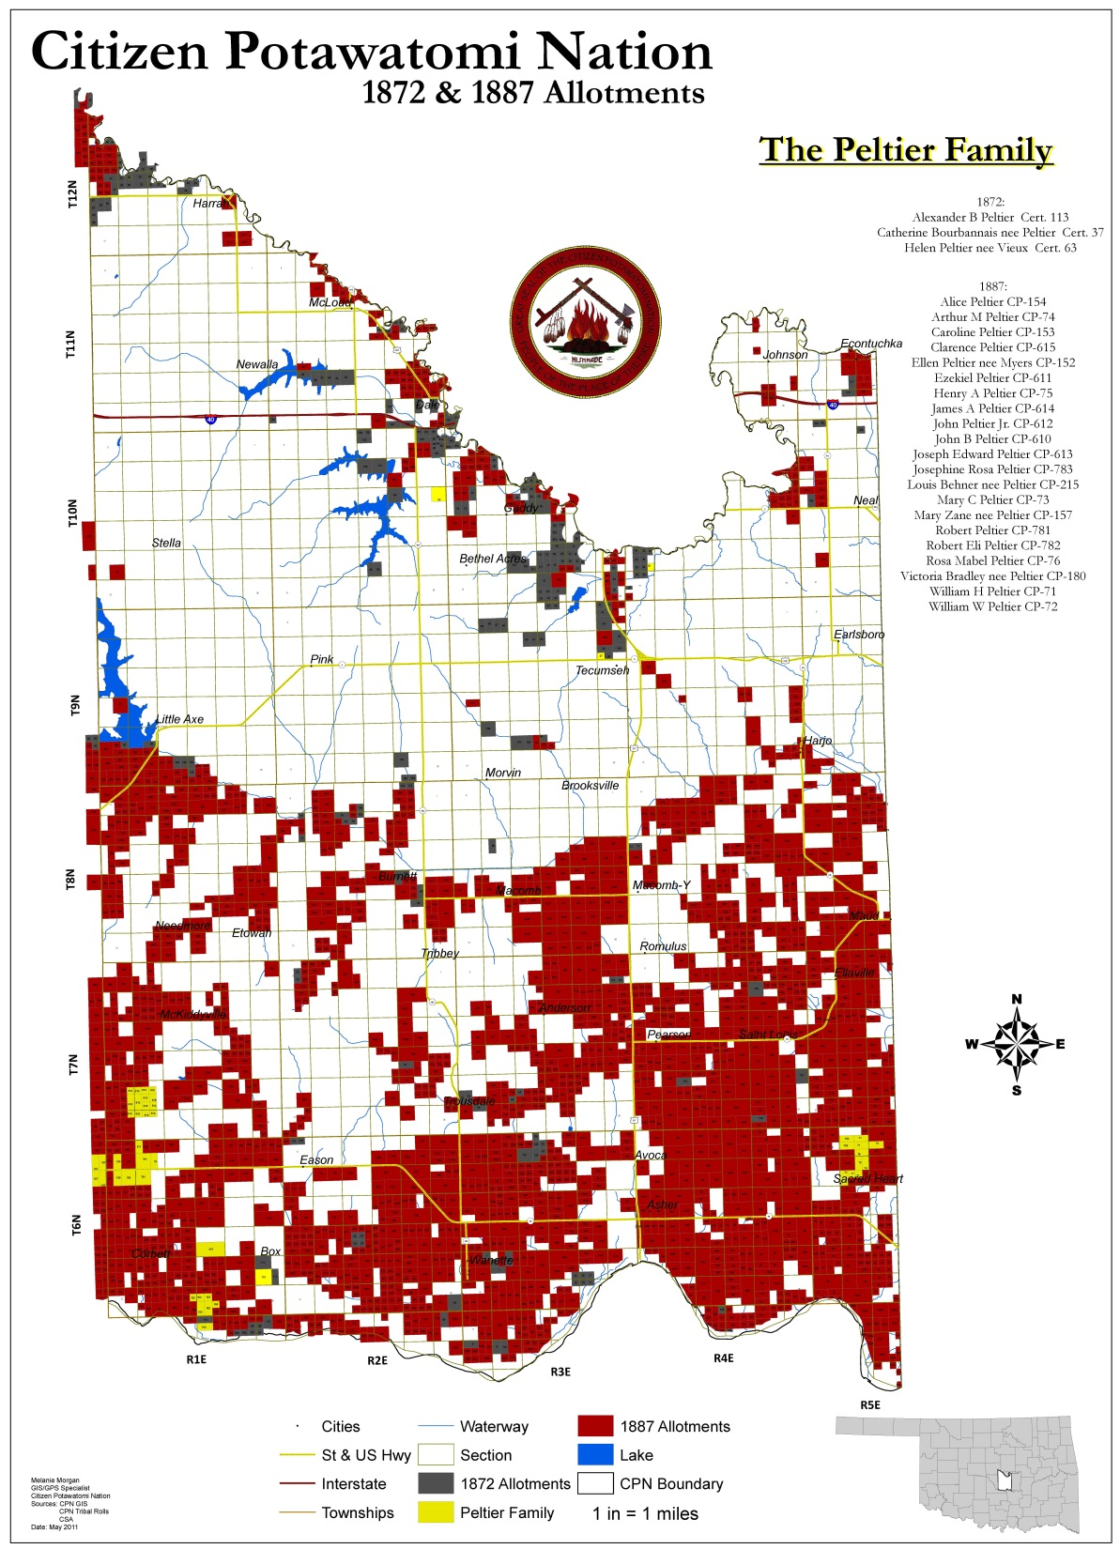
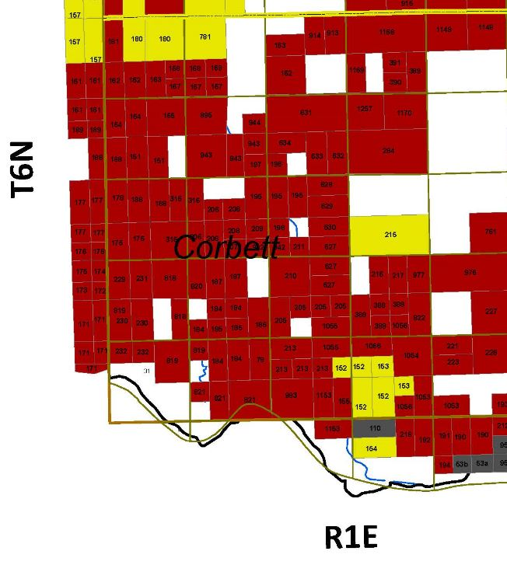

Slide 4
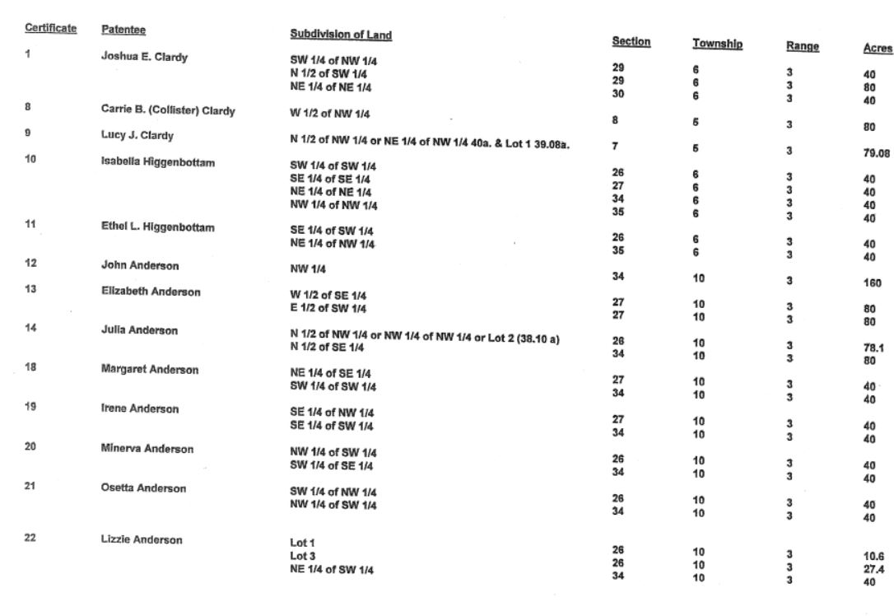
Cert. in front of a number is in reference to the Act of 1872 Allottees
144 INDIVIDUALS LISTED ON THIS ACCOUNT OF THE 1872 or Act of 1872
Good resource to understanding the allotment process of our tribe
The Cultural Politics of Land:
Citizen Potawatomi Allotment and Citizenship in Kansas and Indian Territory, 1861-1891 by Dr. Kelli Mosteller CHC director [also note dissertation information provided by Dennis Place, Politics, and Property: Negotiating Allotment and Citizenship for the Citizen Potawatomi, 1861 -1891Kelli Jean Mosteller, Ph.D]

Slide 5
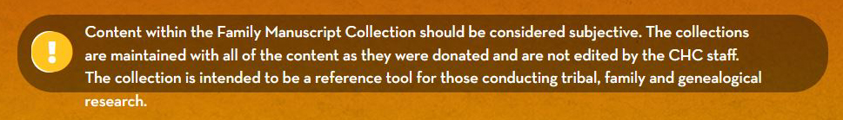
CPN CHC ARCHIVES RESOURCES
FAMILY MANUSCRIPTS , TRIBAL HERITAGE PROJECT VIDEO/INTERVIEWS and COLLECTIONS
FAMILY MANUSCRIPTS aka FAMILY COLLECTIONS aka GRAY DOCUMENT BOXES
SPELLING DOES NOT COUNT .....OR DOES IT? Just be aware of the possibilities!
Phonetics is your friend …and understanding the vowel sounds in other languages helps also French version of Steven, Stephan is Etienne …Eli is Hilary
People married and remarried and I am surprised at how many actually divorce or leave a marriage to both remarry create some interesting family dynamics!
Everyone named their children after their siblings …sometimes creating to I have the correct Margaret???? ….Auntie or Niece? Birthdates/years are important
You know your ancestor’s surname was Melot/Melott but is spelled Milot on the 1887 and Melot on the 1873

Slide 6
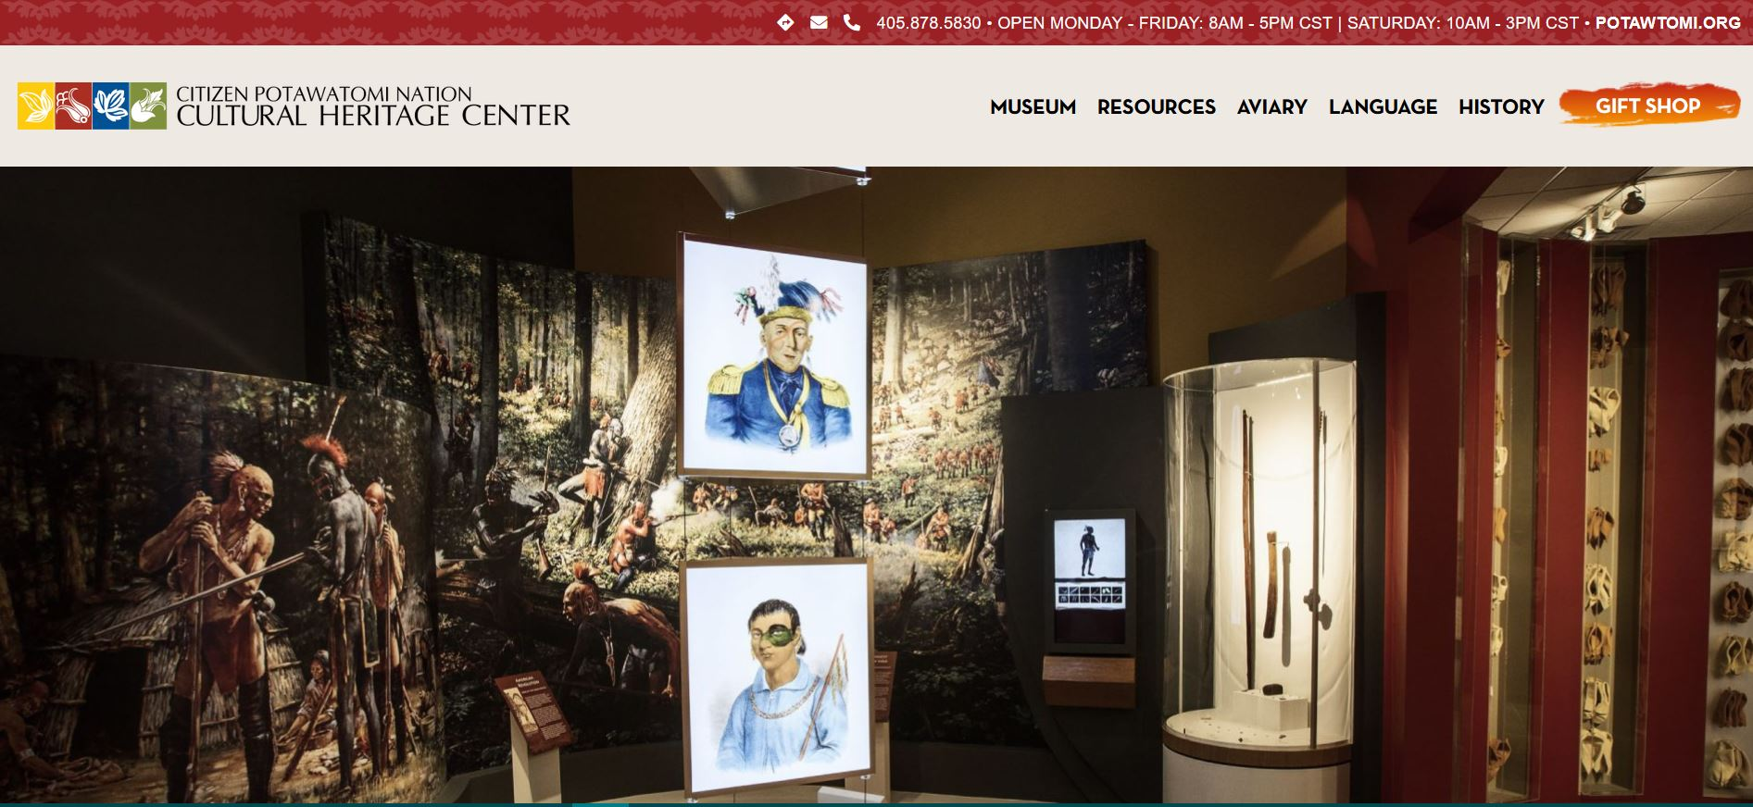

Slide 7
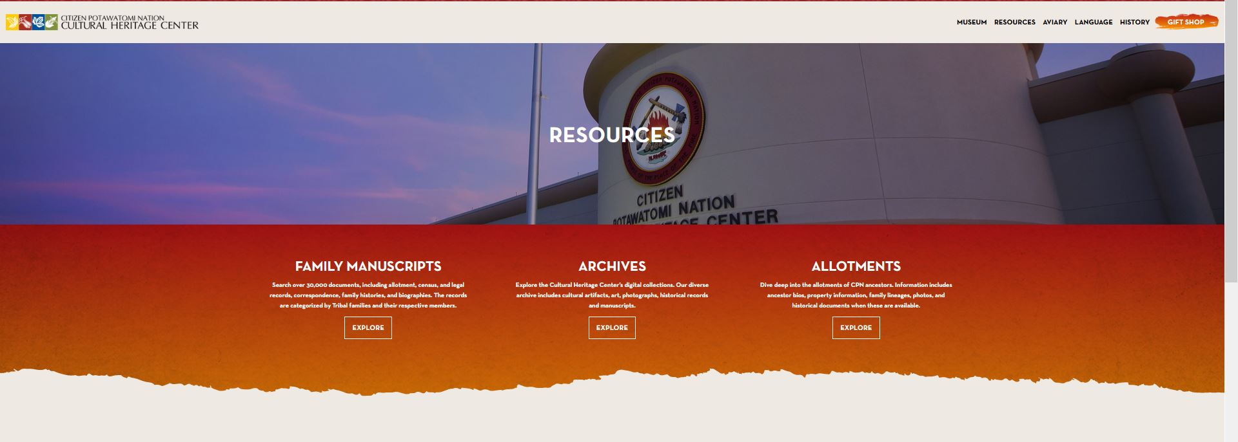

Slide 8
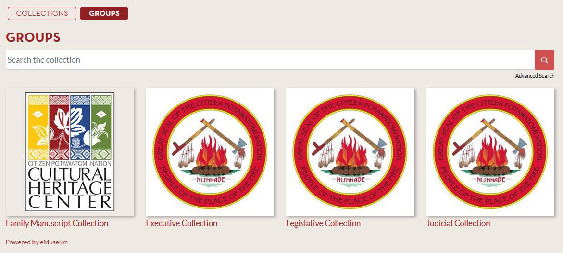
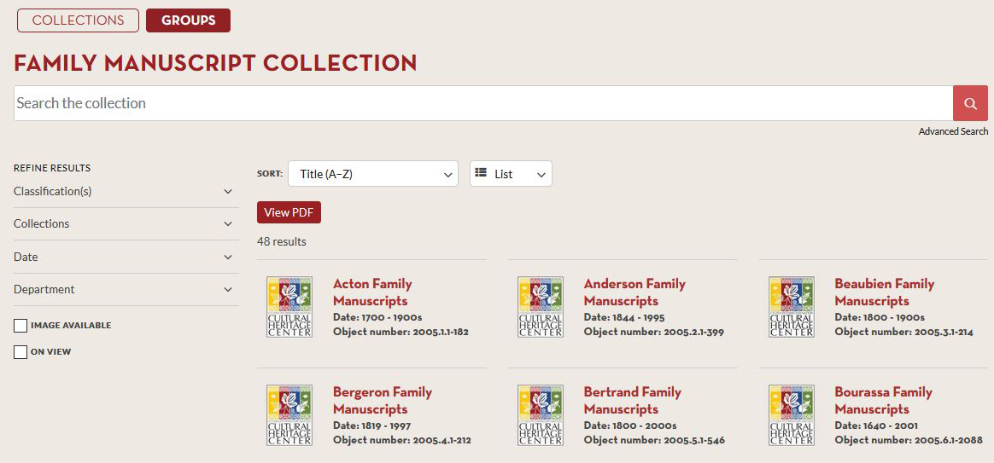

Slide 10
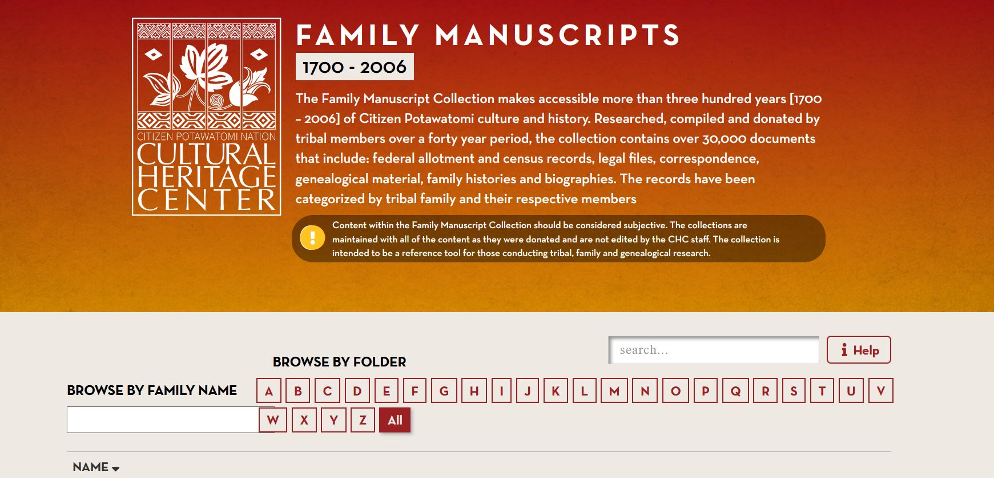
SEARCH BY INDIVIDUAL IS HELPFUL FOR THOSE THAT MAY NOT FALL UNDER ONE OF THE FAMILY MANUSCRIPTS/GRAY DOC BOXES …..SMITH AND SLAVEN ARE TWO FAMILIES THAT ONE COULD CONTACT ME ON FOR FAMILY INFORMATION NOT AVAILABLE IN FAM. MANU.

Slide 11
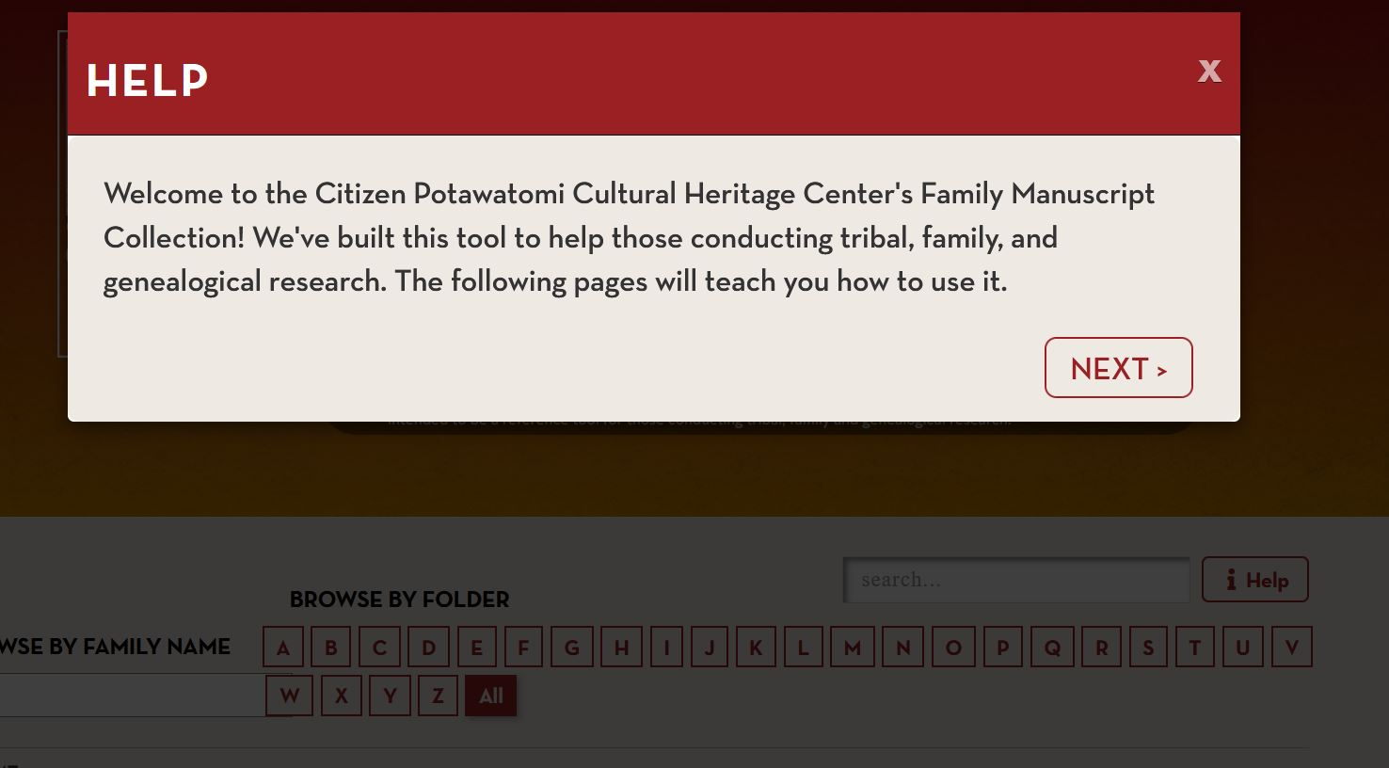
STRONGLY SUGGEST USING THE HELP BUTTON ….AS MOST HELP BUTTONS VERY HELPFUL AND WILL MAKE YOUR RESEARCH TIME HERE MORE PRODUCTIVE !

Slide 12
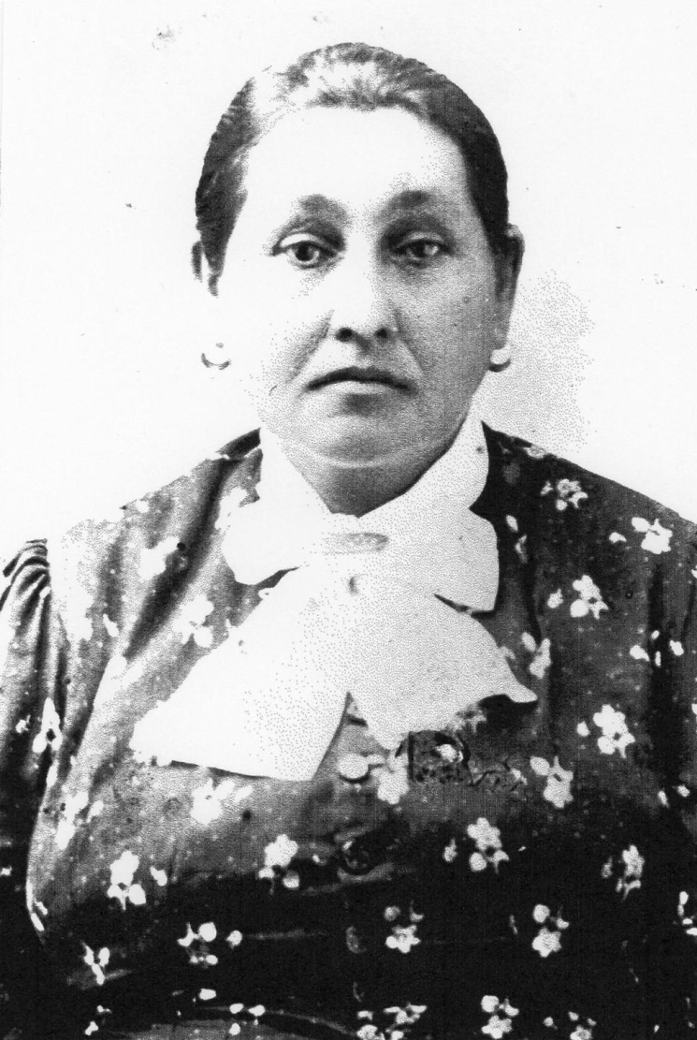
CP # 900 MADILINE DENTON nee LAFROMBOISE 1853~1910
DAUGHTER OF CHIEF JOSEPH LAFROMBOISE/LEFROMBOISE AND THERESA PELTIER
Notes:
CP 900 MADILINE DENTON

Slide 13
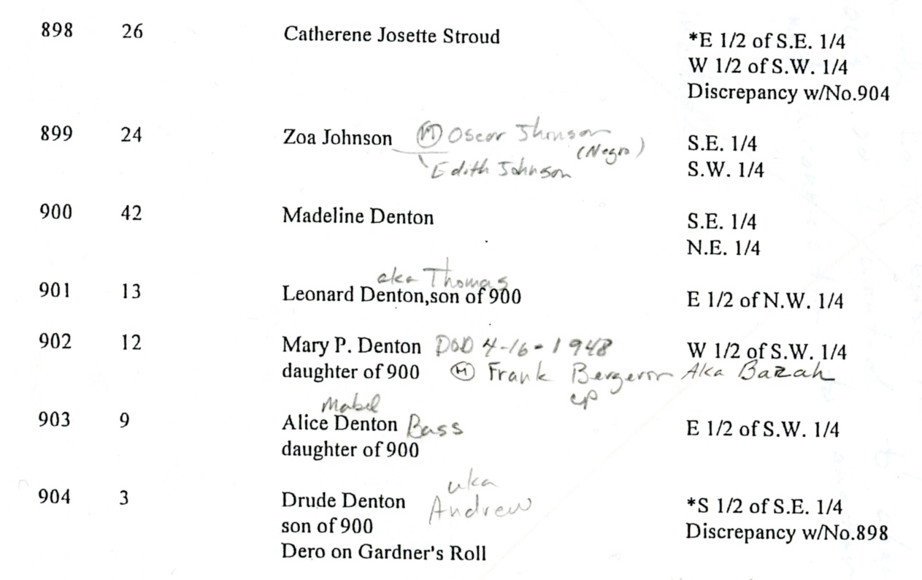
From the 1887 allottee roll

Slide 14
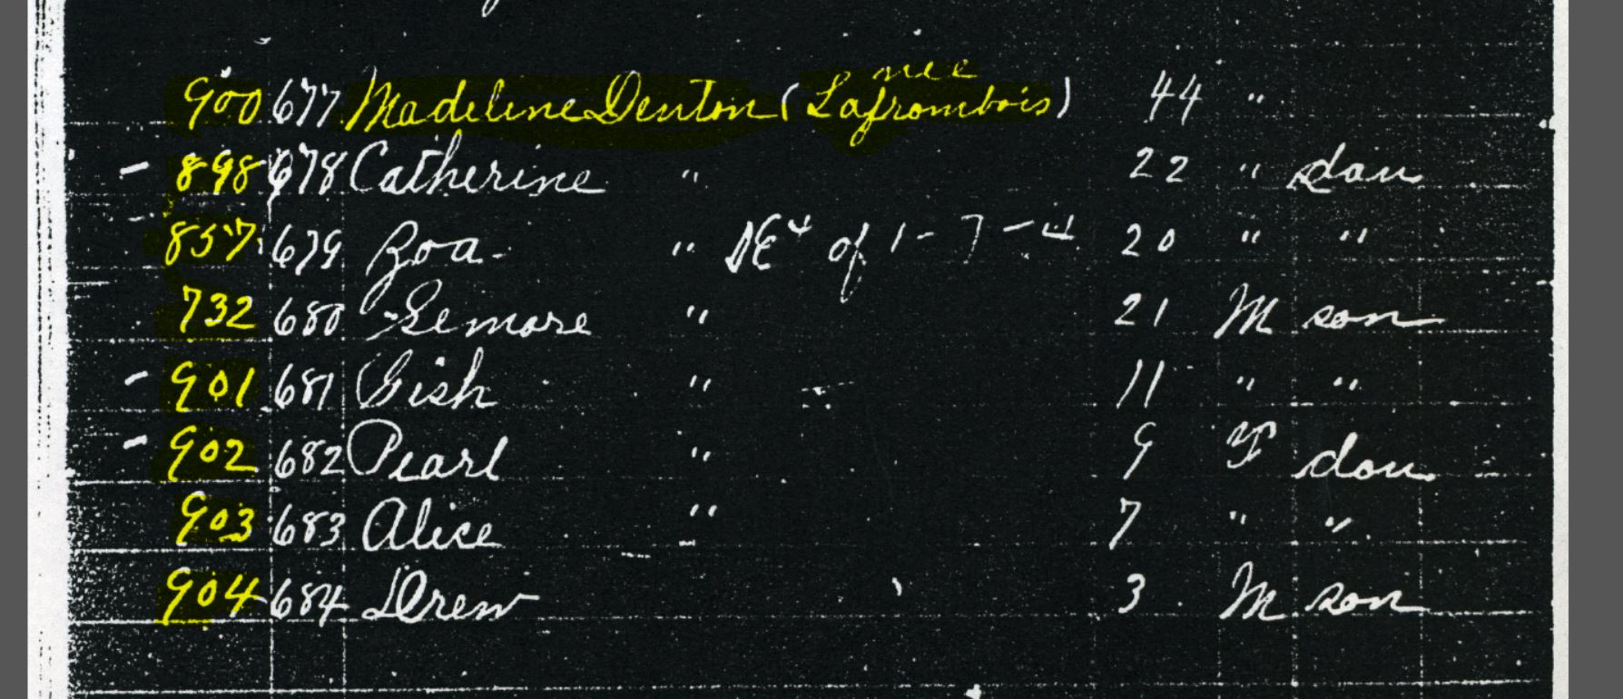
1890 GARDNER ROLL
Notes:
1890 Gardner roll

Slide 15
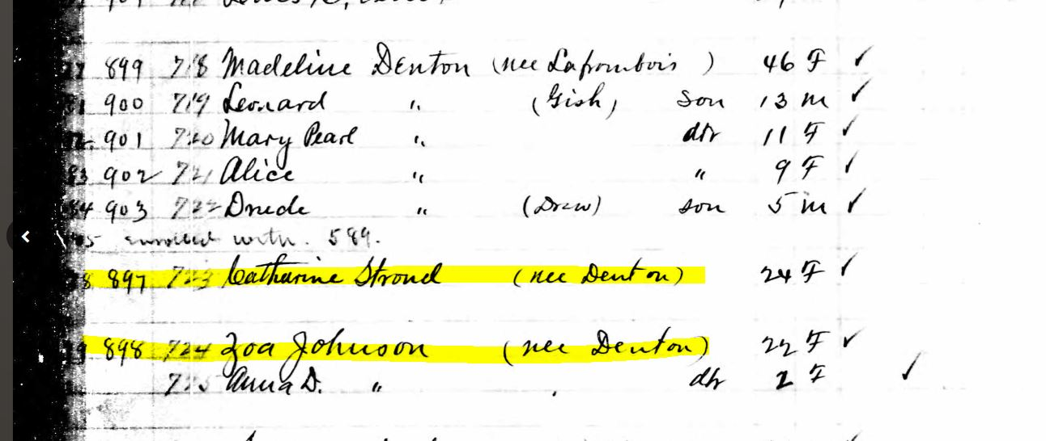
1891 ANNUITY PAYMENT DOCUMENT FOR CITIZEN POTAWATOMI

Slide 16
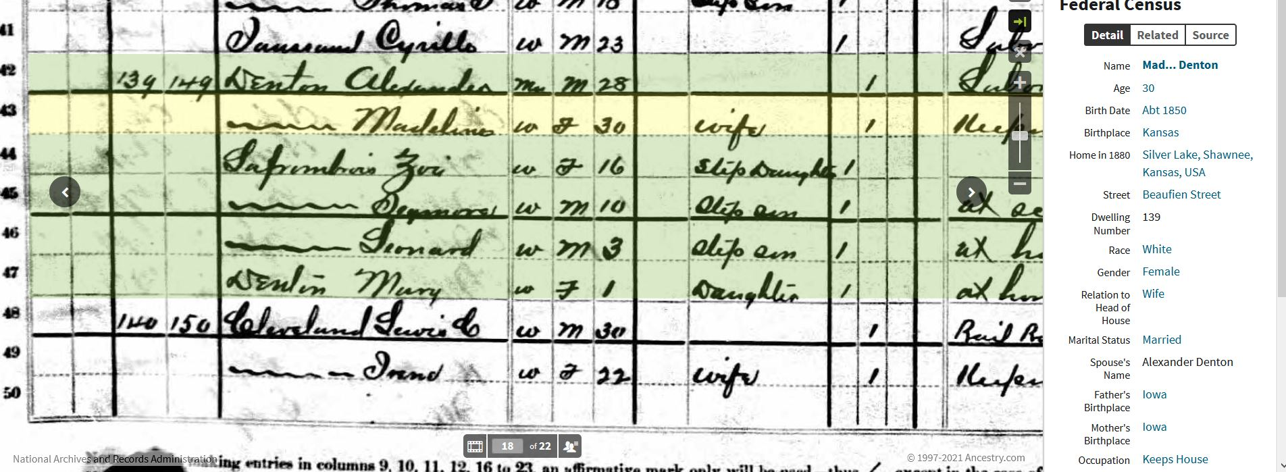
1880 CENSUS SILVERLAKE KS

Slide 17
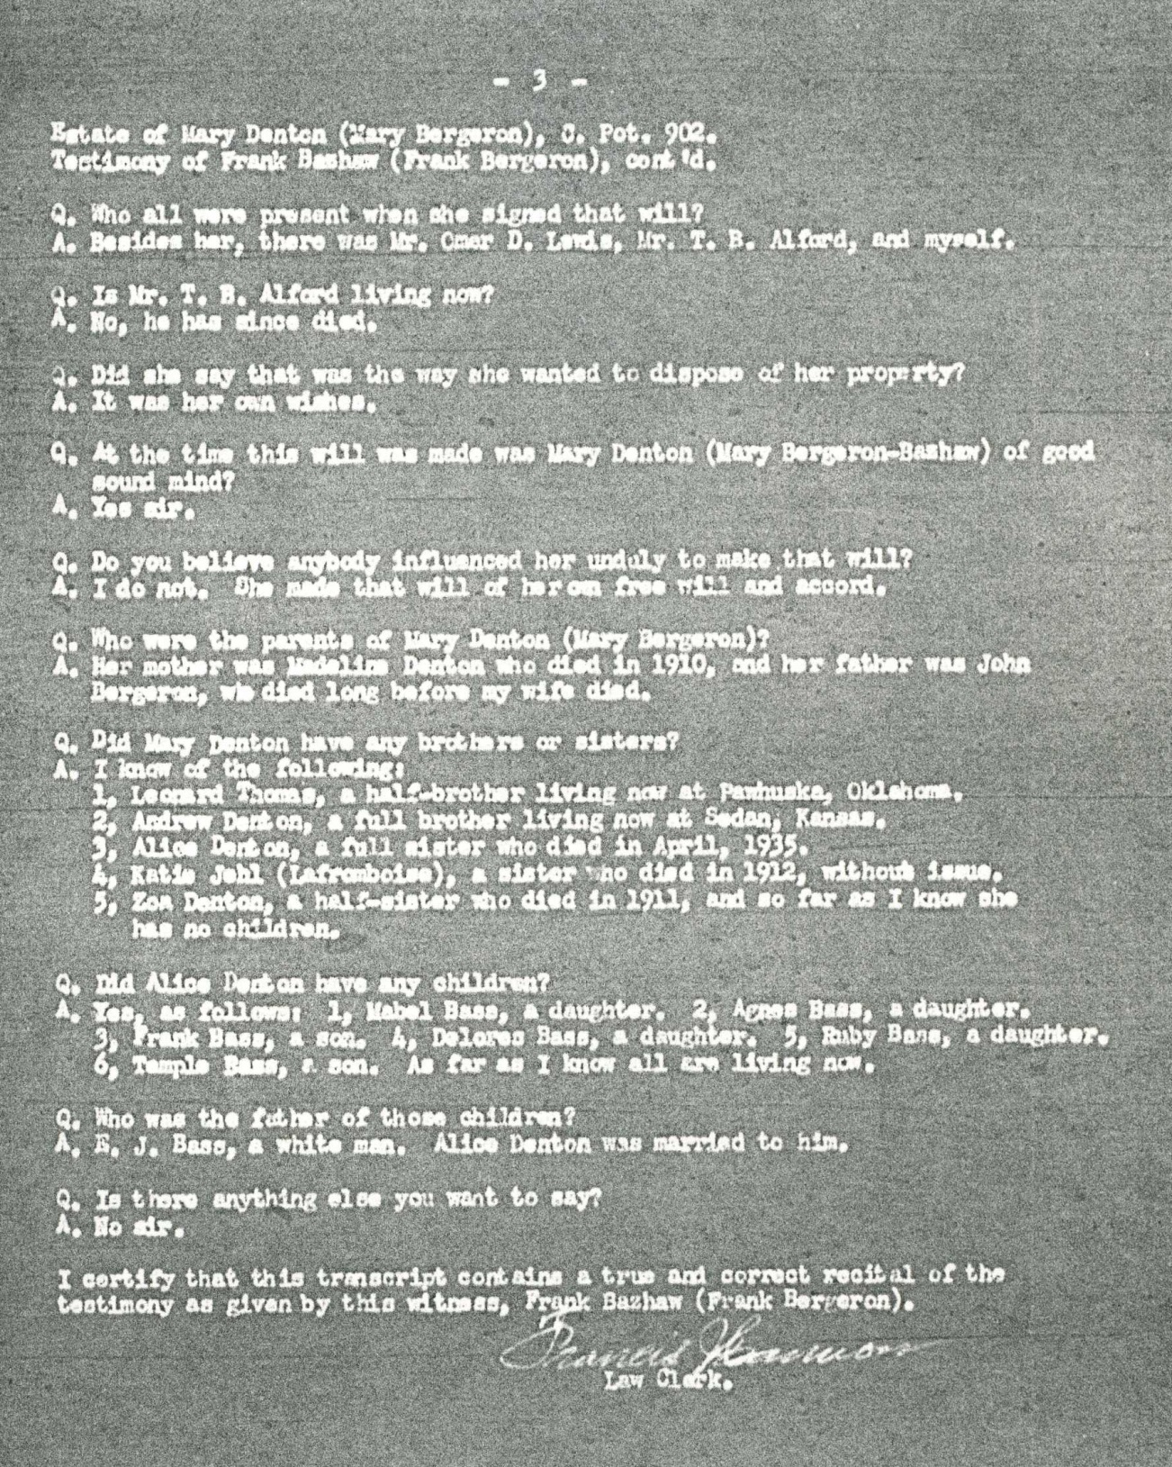

Slide 18
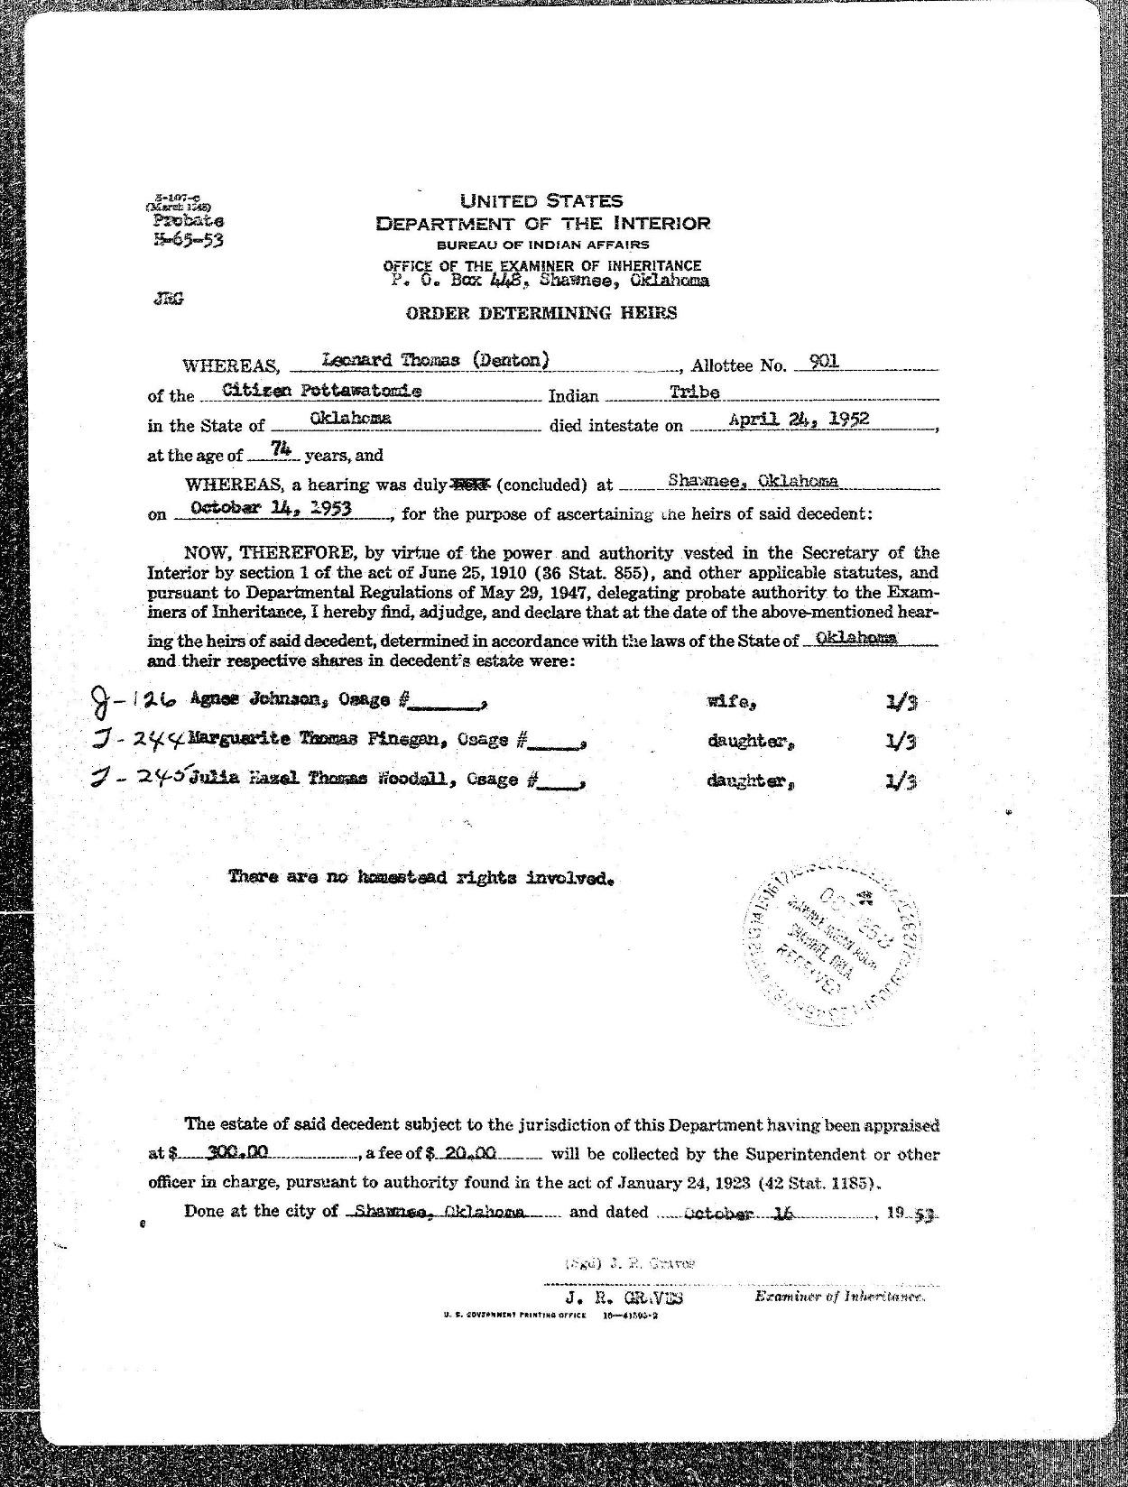

Slide 19
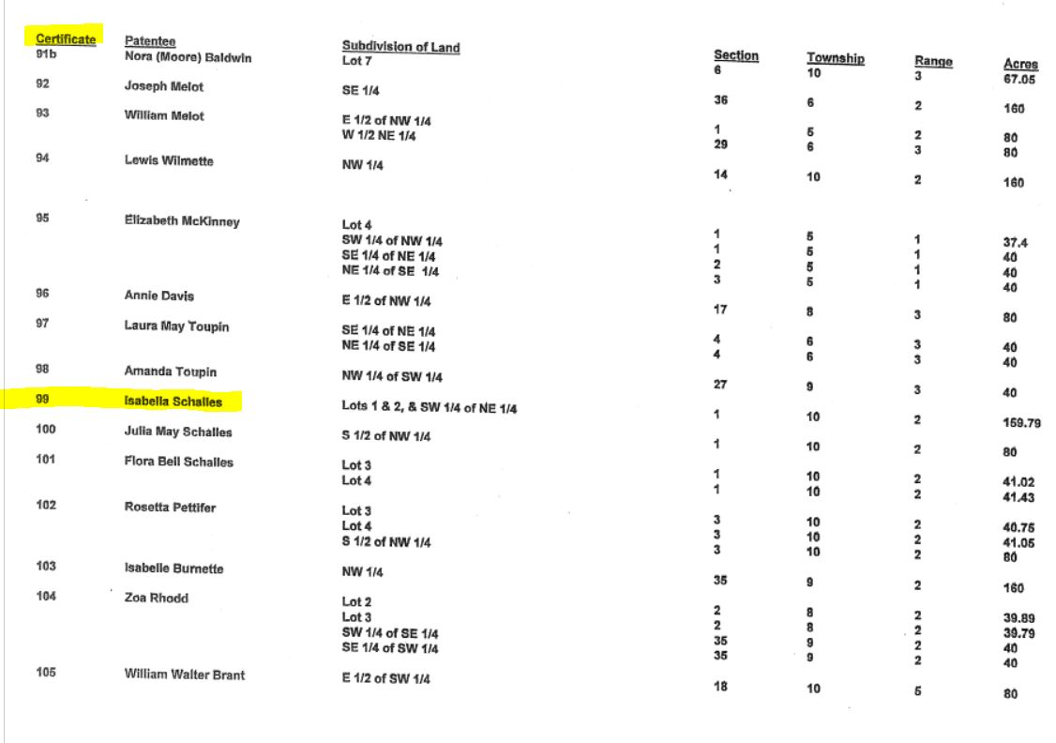

Slide 20
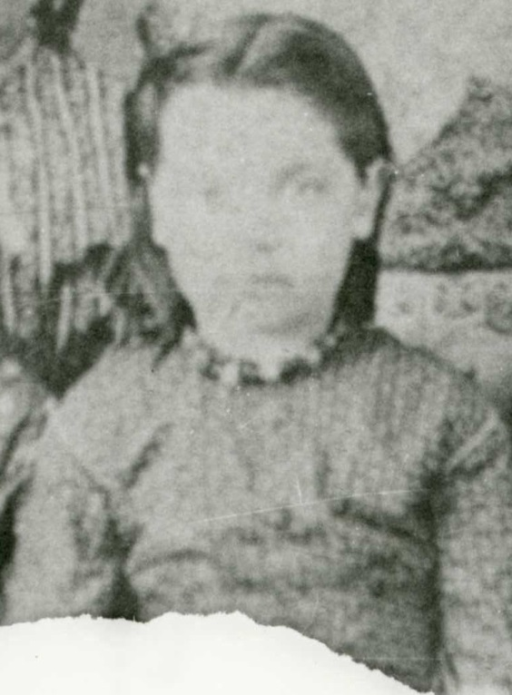
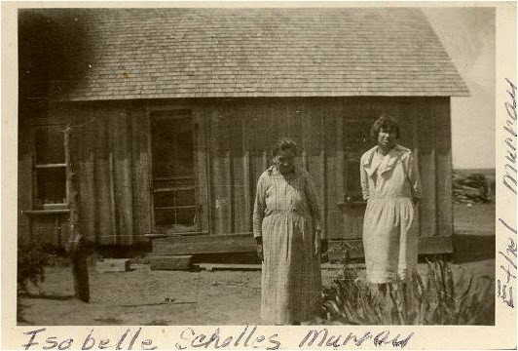
Isabelle Pettifer Schalles Murrey

Slide 21
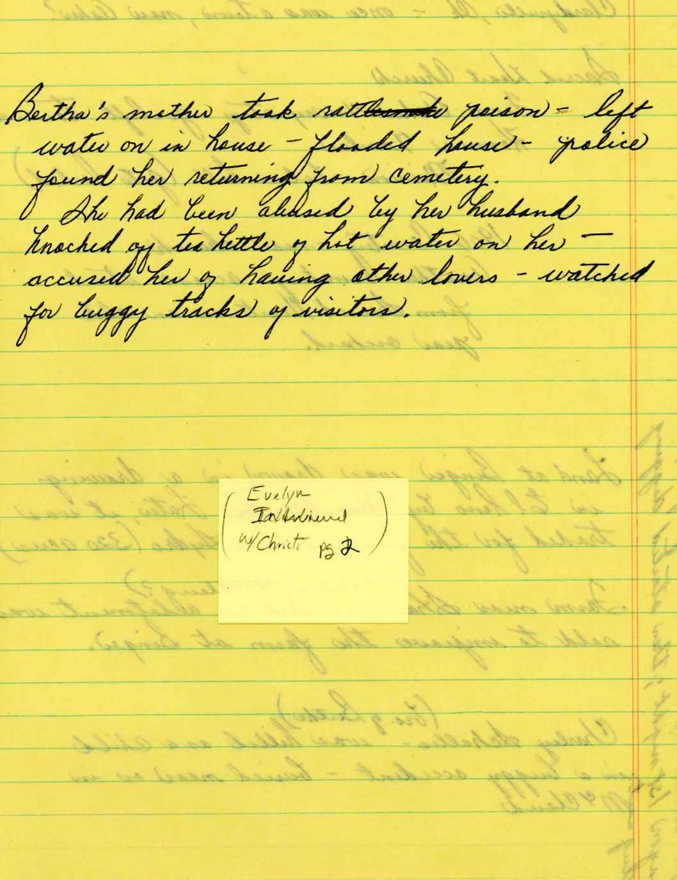

Slide 22
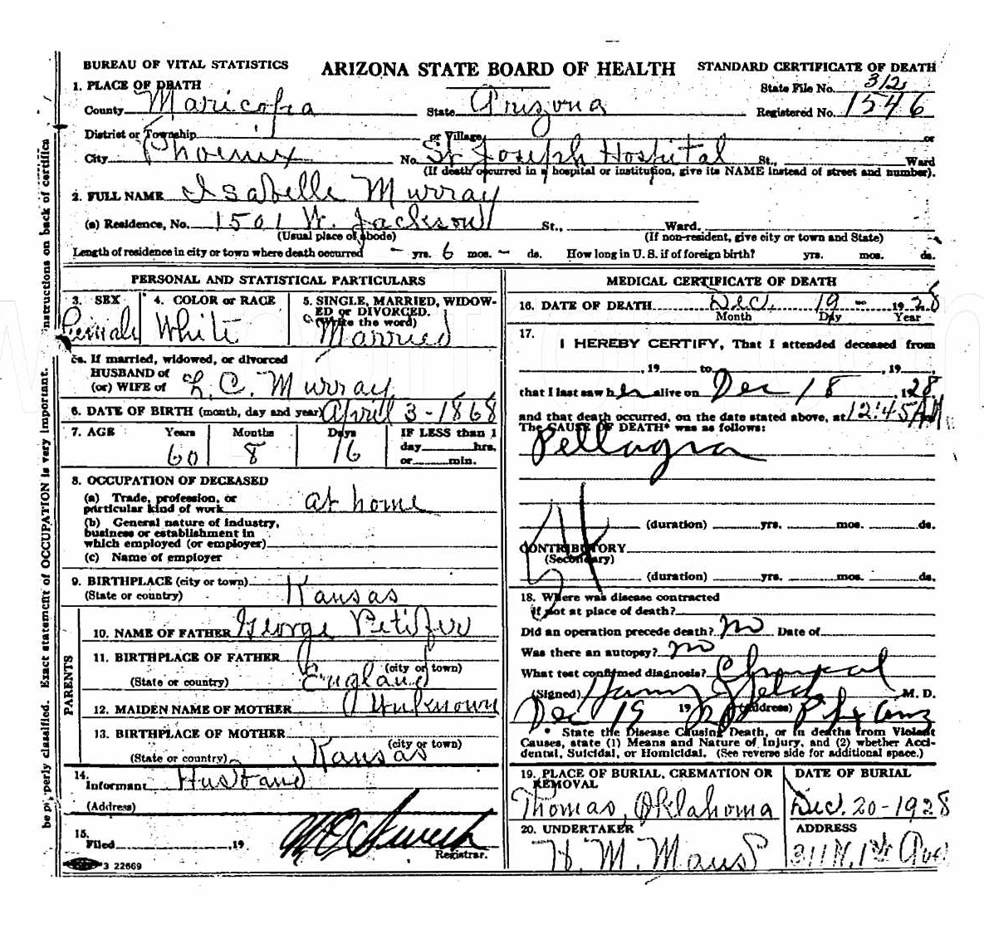
B3/NIACIN DEFICIENCY
SYMPTOMS : DERMATITIS, DEMENTIA & DIARRHEA

Slide 23
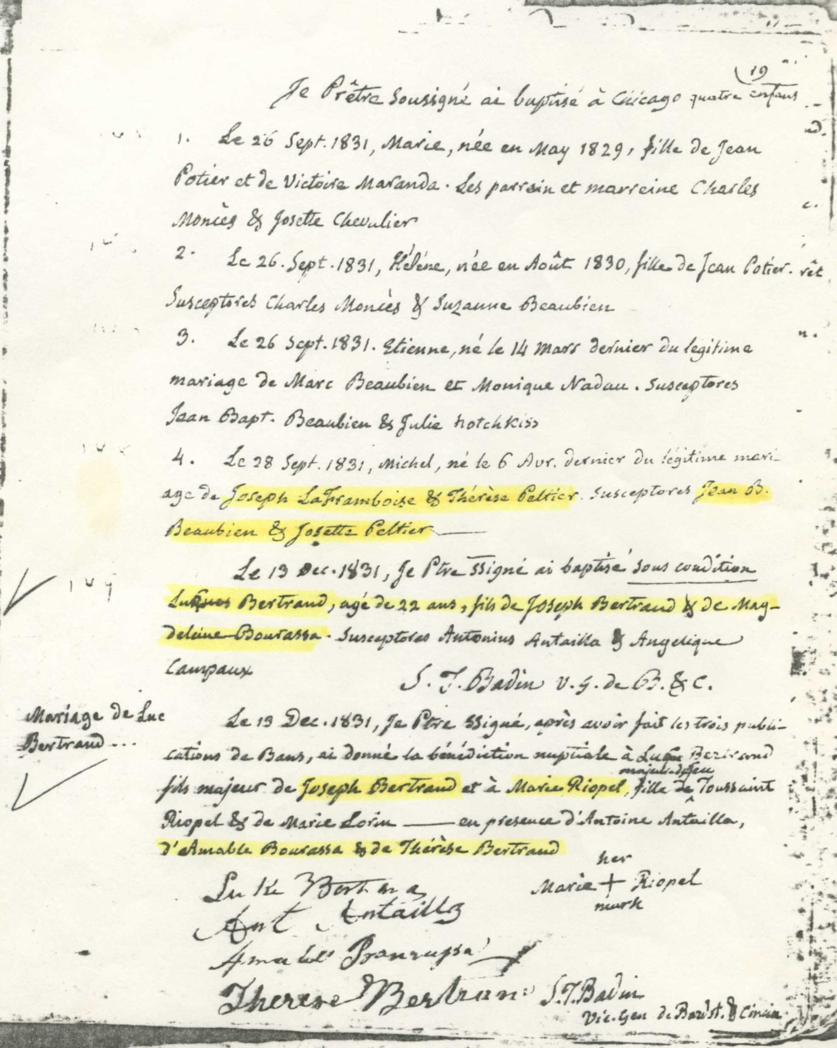

Slide 24
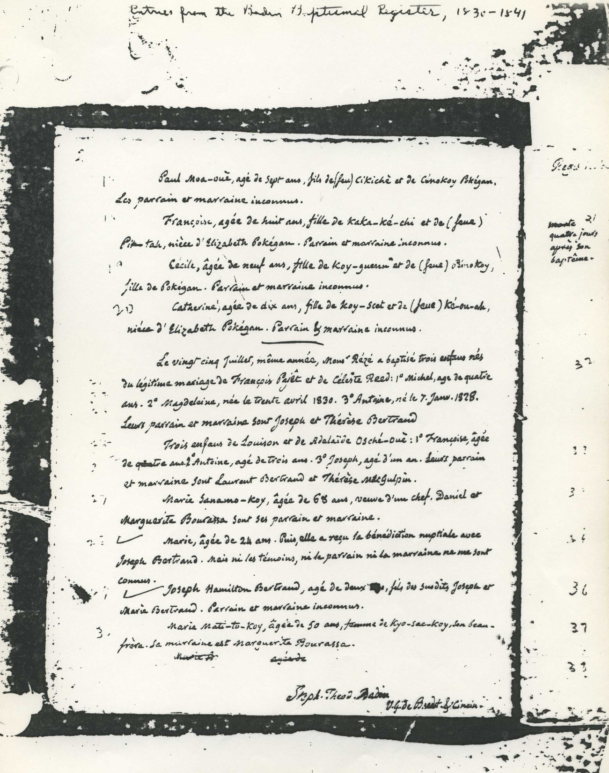
FATHER STEPHEN T. BADEN BAPTISMAL REG.
1830-1841

Slide 25
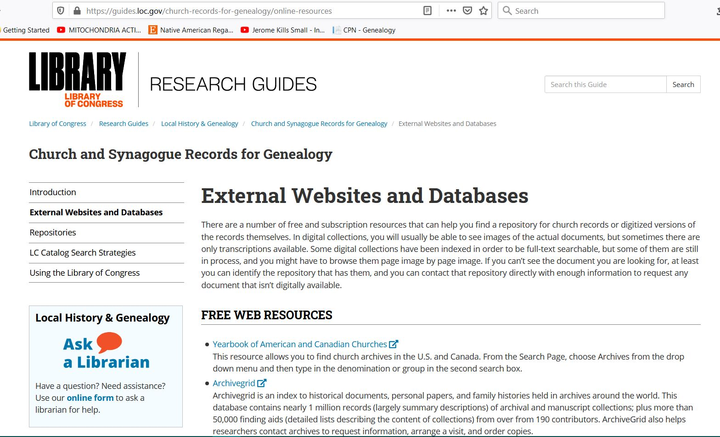

Slide 26
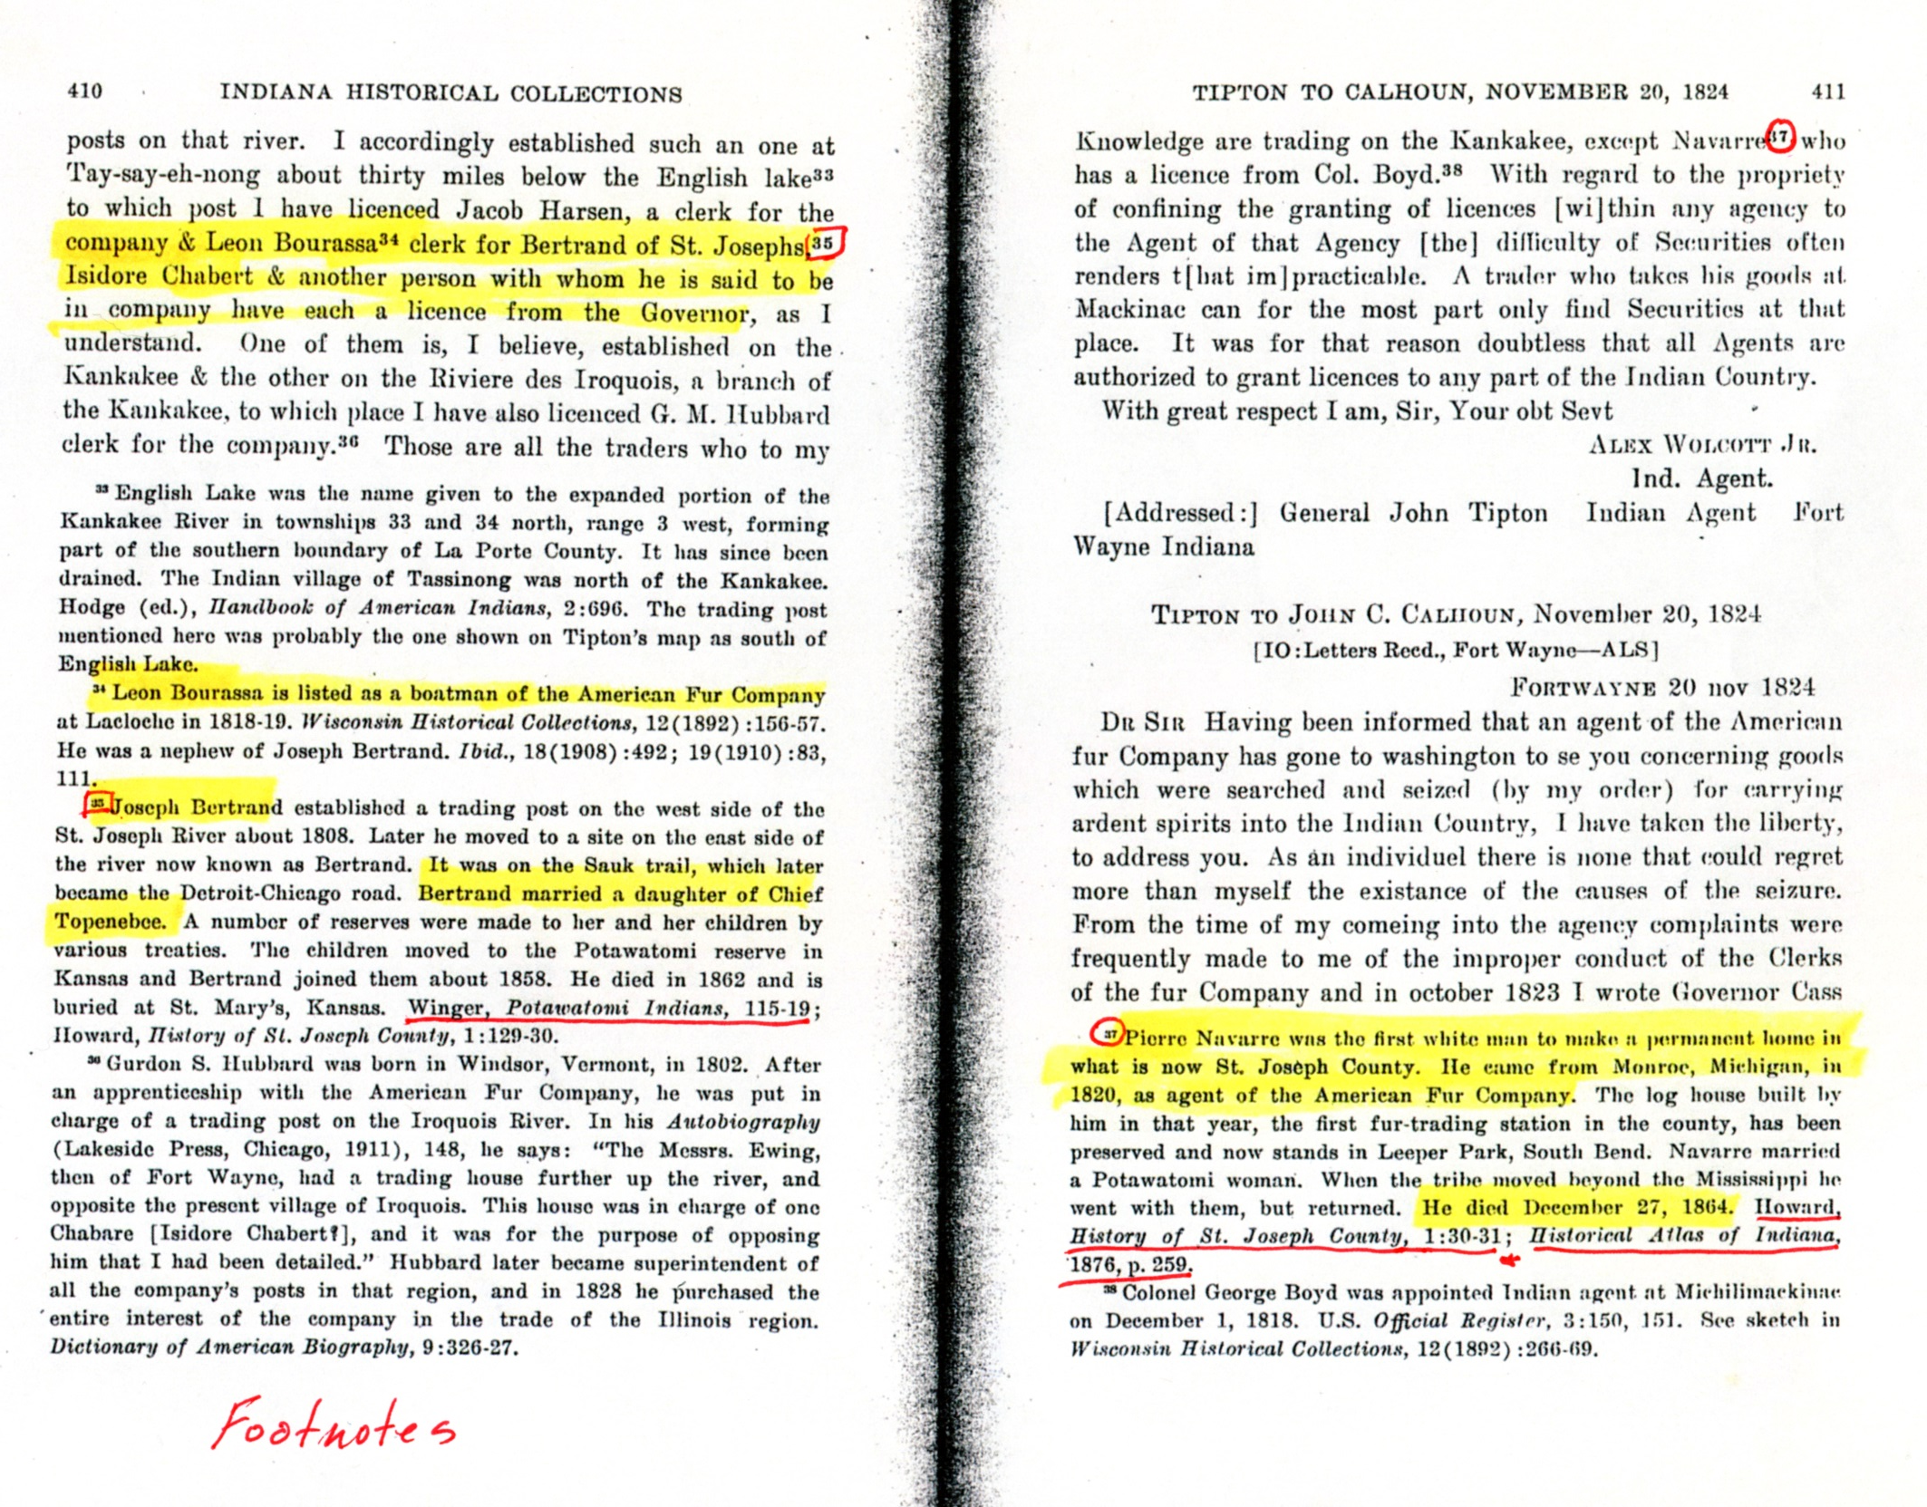

Slide 27

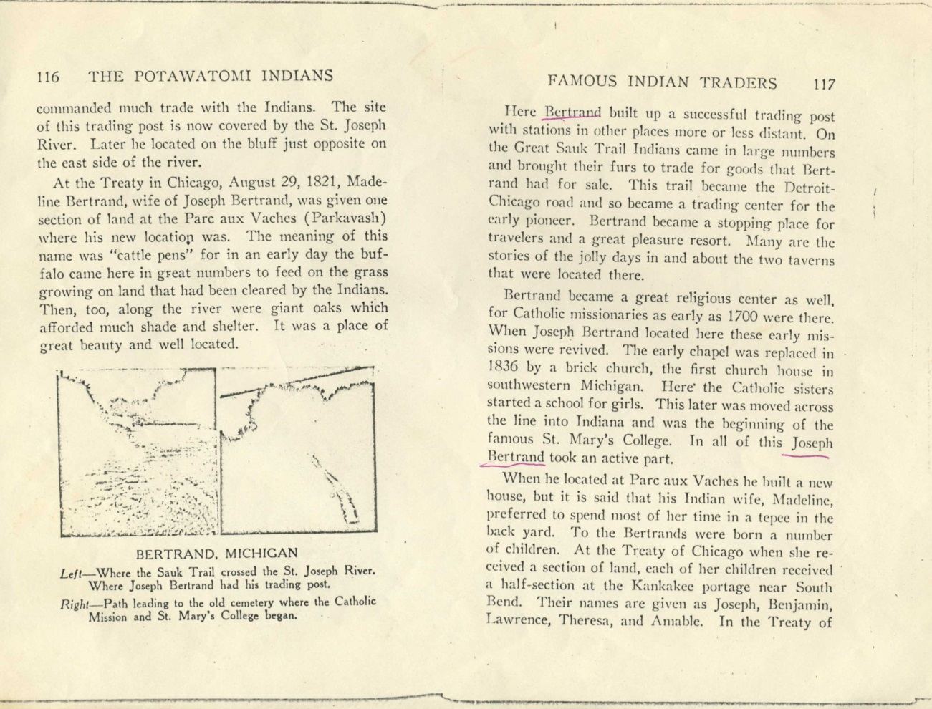

Slide 28
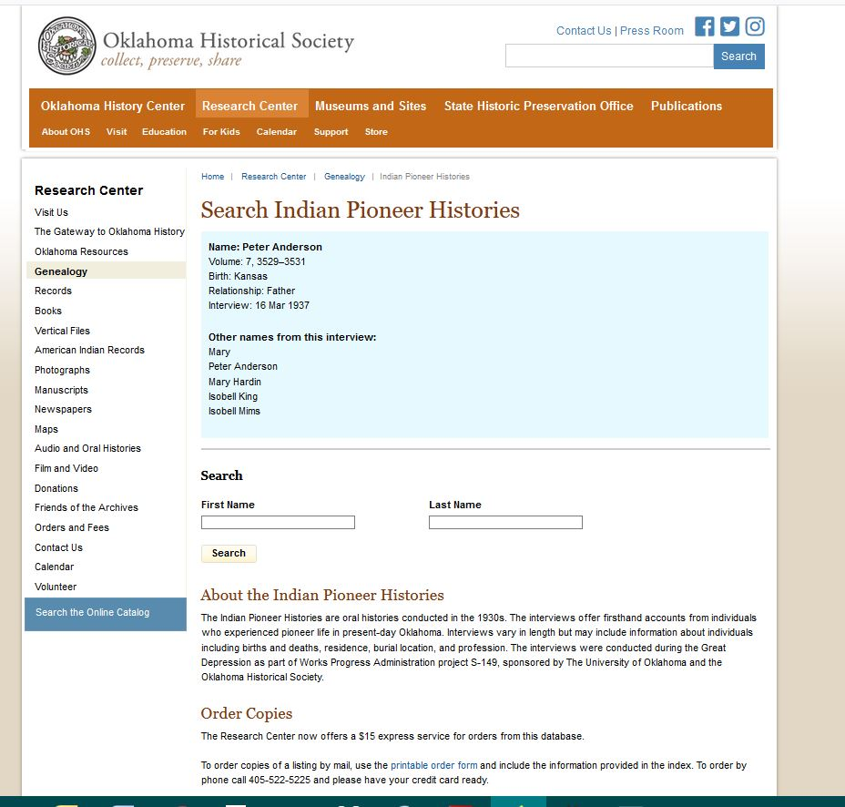

Slide 29
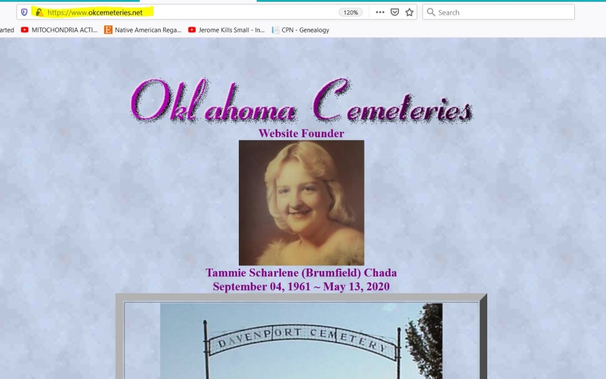
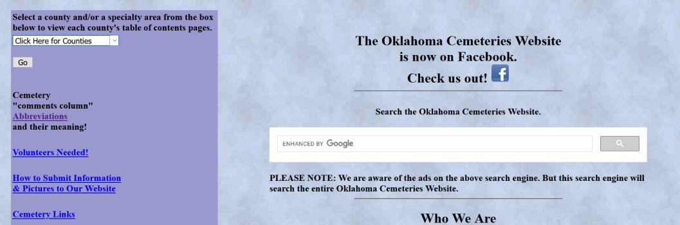
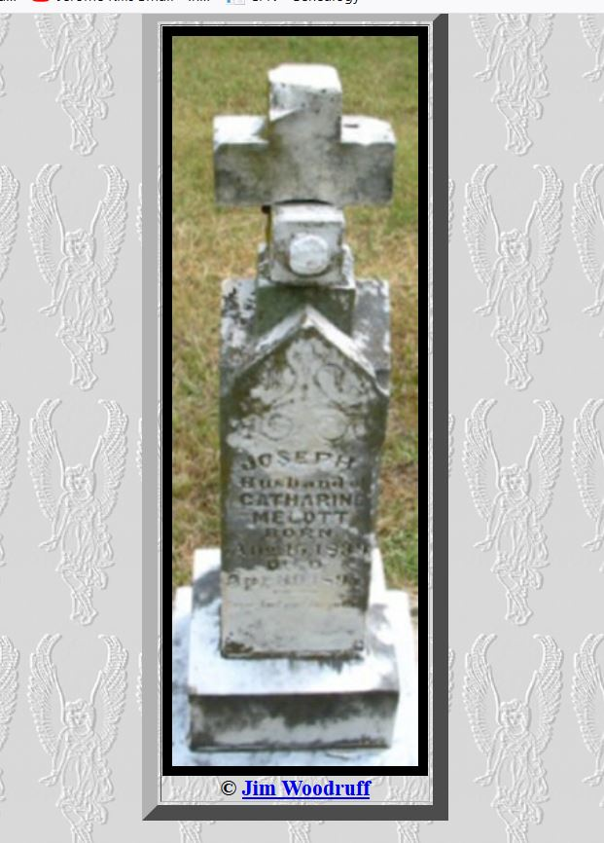
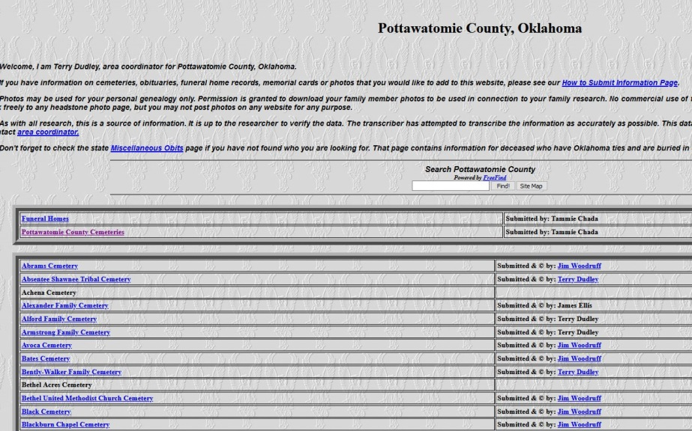
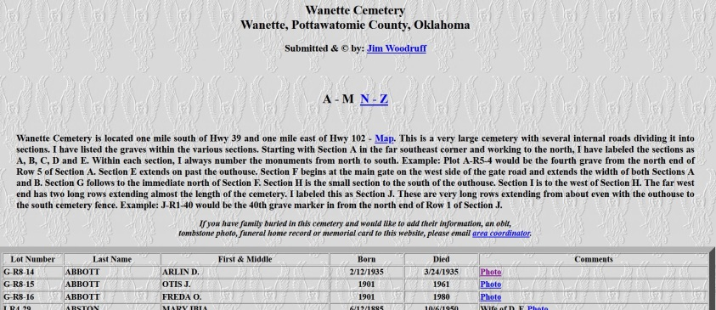

Slide 30
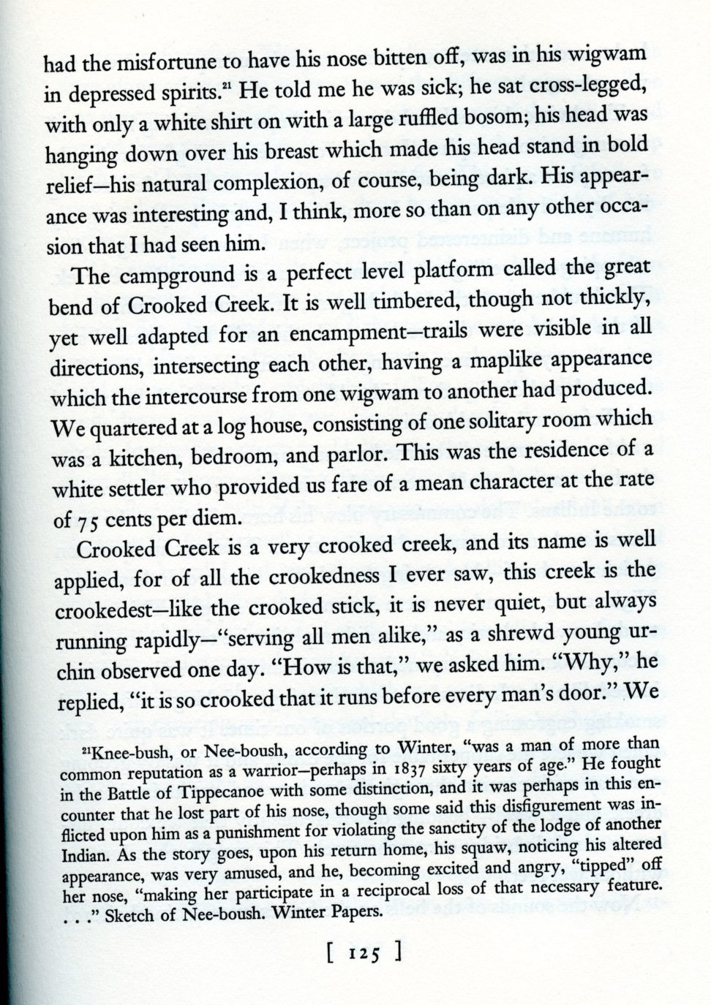
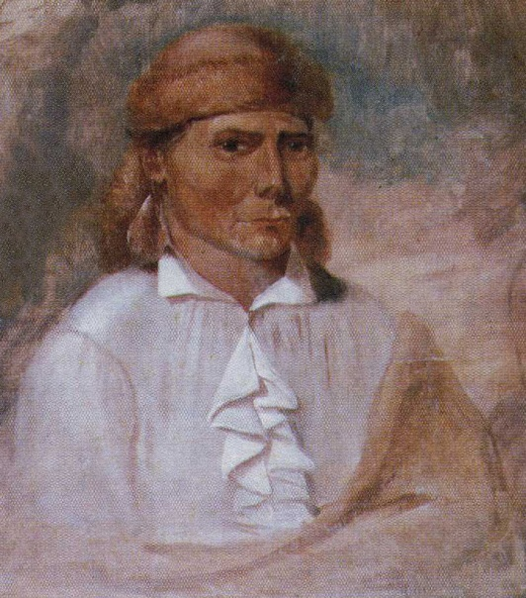
George Winter
(a primary resource)
estimated Nee-Boush @ 60 yr in 1837 = birth yr around 1777

Slide 31
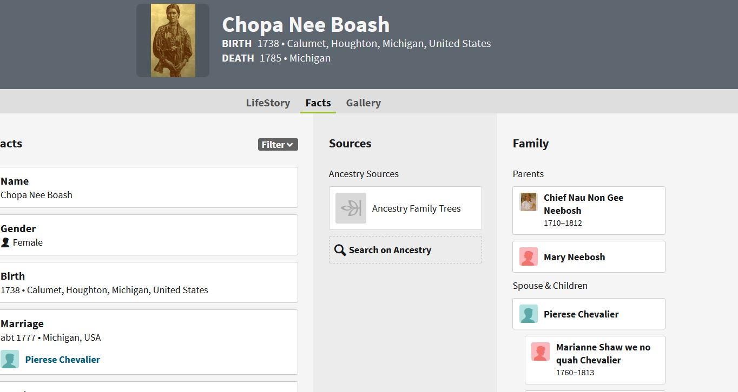

Slide 32
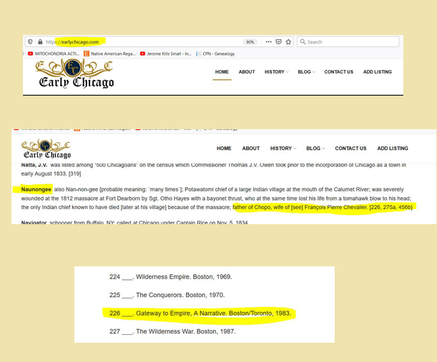

Slide 33
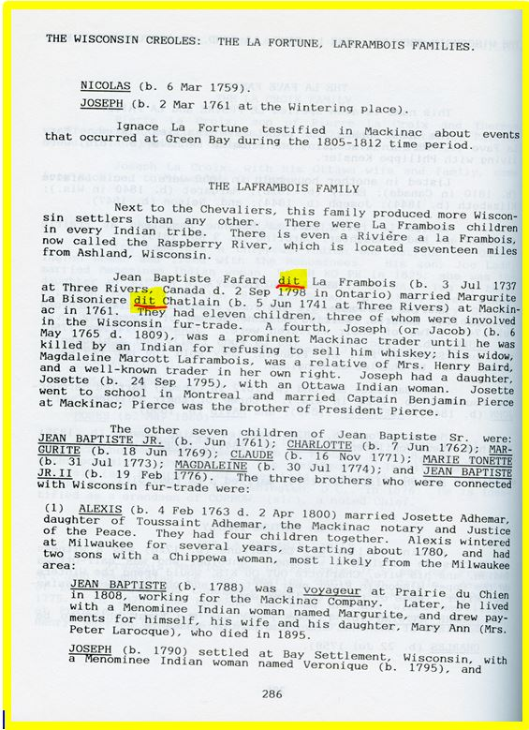
A dit name is an alias or nickname, in essence a second surname, given to a family…. A dit name doesn't usually apply to one person, but to many members and generations of a family.

Slide 34
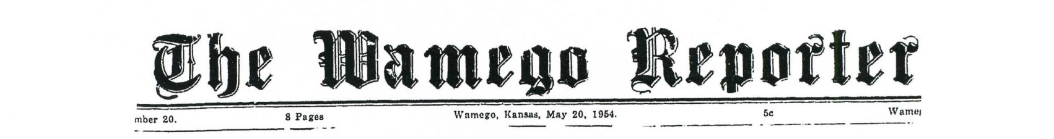
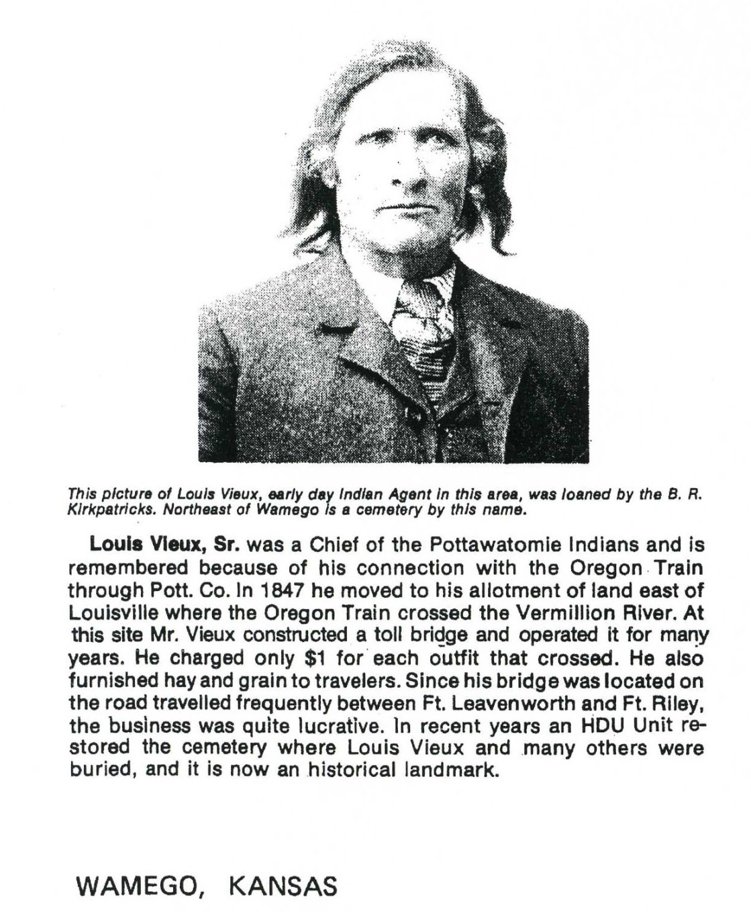
This is not an image of Louis Vieux Sr. …it is Jacob John Derringer

Slide 35
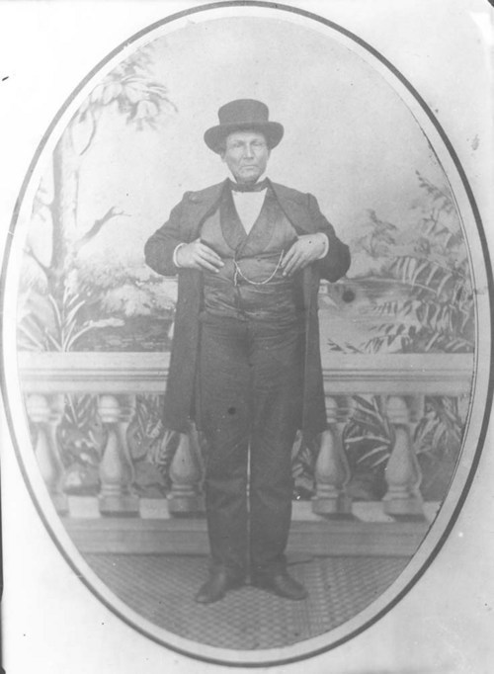
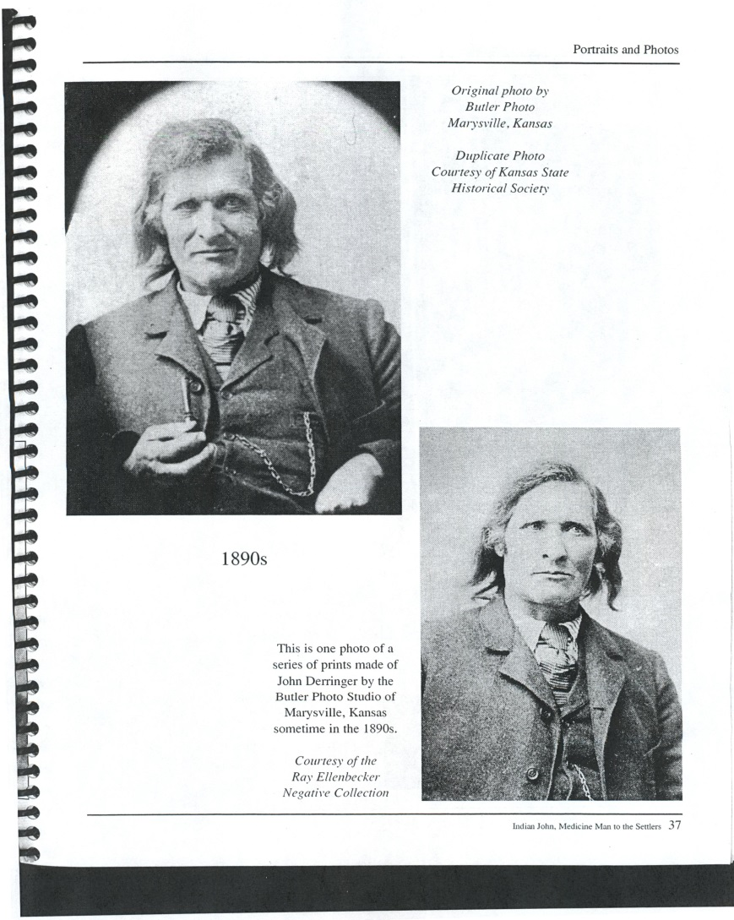
Pg. from “Legacy of the Talking Crow” book about JACOB JOHN DERRINGER aka Indian John medicine man
LOUIS VIEUX SR.

Slide 36
SEEK out Elders and or the Family Historian seems as if most families have one …and listen, ask and learn...
Also try to LOCATE THEIR HARD EARNED FAMILY RESEARCH …inherited and gifted …and hopefully never lost!
REVISIT YOUR NOTES; BOOKS, RESOURCES….again and again …recognition will be based on your knowledge base and as it grows so will your ability to recognize key family information…….
Sometimes some of the best resources and leads … is never were you imagined ……..
Google Google Google ….everything and anything ….
Always look for and at the resource attributed to family history information and always find two or more forms of documentation etc. to support information …when using information please provide source for those coming behind ….and question if there is no source given …you do not want to perpetuate half truths or misleading information
AND OF COURSE IF ALL ELSE FAILS …PLEASE CONTACT ME @ cthompson@potawatomi.org
CPN CHC ARCHIVES 405-878-5830
JUST ASK FOR “CZAR” OR FAMILY HISTORY PERSON ETC…..

